Slide 1


Anastasiia Trofimova
01/23/2025

Slide 2

Outline
Executive Summary
Introduction
Methodology
Results
Conclusion
Appendix

Slide 3
Executive Summary
Web Scraping
Utilized web scraping techniques to extract SpaceX launch data from an online source.
Processed and stored the collected data for analysis and reporting.
Data Collection Using APIs
Accessed SpaceX data through APIs to collect detailed information about launches.
Implemented data normalization and structured the collected information for further analysis.
Data Wrangling
Cleaned and preprocessed SpaceX data to handle missing values, inconsistencies, and redundancies.
Transformed data into a structured format suitable for analytical and machine learning tasks.
Exploratory Data Analysis (SQL)
Leveraged SQL queries to perform initial exploratory analysis of launch data.
Identified patterns and key metrics, such as success rates and payload trends.
Exploratory Data Analysis (Visualization)
Conducted visual data analysis using Python libraries like Matplotlib and Seaborn.
Visualized relationships between launch outcomes, payload mass, orbit types, and other variables.
Launch Site Location Analysis
Analyzed geographical launch site data to evaluate site-specific factors affecting launch success.
Used geospatial visualizations to illustrate site effectiveness and distribution.
Machine Learning Prediction
Developed a classification model to predict the success of SpaceX launches.
Selected and evaluated machine learning algorithms for optimal performance.
Assessed model accuracy and derived actionable insights from predictions.

Slide 4
Executive Summary
Summary of All Results
Extracted comprehensive datasets through web scraping and APIs for analysis.
Identified significant trends, such as correlations between payload mass, orbit type, and launch success.
Visualized key patterns and insights using SQL and advanced visualization techniques.
Demonstrated the importance of launch site selection and its impact on mission outcomes.
Built and evaluated a machine learning model with high accuracy to predict launch success.
Delivered actionable insights for SpaceX’s operational strategy, enabling data-driven decision-making for future launches.

Slide 5
Introduction
Project Background and Context
SpaceX has revolutionized the space industry with its reusable rocket technology, making space exploration more cost-effective and accessible.
The project aims to analyze SpaceX launch data to derive insights and support data-driven decisions for optimizing launch success and operational strategies.
This study leverages data science techniques such as web scraping, API integration, data wrangling, exploratory analysis, and machine learning to uncover valuable insights.
Problems You Want to Find Answers
What factors influence the success of a SpaceX launch?
How do payload mass, orbit type, and other variables affect launch outcomes?
Which launch sites are the most effective in ensuring successful missions?
Are there geographical or operational factors contributing to differences in success rates?
Can we predict the success of a SpaceX launch based on historical data?
How accurately can machine learning models forecast launch outcomes?

Slide 6

Section 1

Slide 7
Methodology
Data Collection Methodology
Web Scraping:
Extracted SpaceX launch data from publicly available online sources using Python web scraping libraries.
API Integration:
Collected additional detailed launch data from SpaceX's API, including payload, orbit, and mission outcome information.
Data Wrangling
Cleaned and preprocessed raw data to handle:
Missing values.
Data inconsistencies.
Redundancies.
Transformed the dataset into a structured format for further analysis.
Data Processing
Normalized and standardized data fields for consistency.
Created derived columns and features relevant to analysis and predictions (e.g., success/failure indicators, payload categories).
Exploratory Data Analysis (EDA)
SQL-Based Analysis:
Used SQL queries to identify trends, calculate success rates, and analyze payload impacts.
Visualization:
Applied Python visualization libraries (Matplotlib, Seaborn) to uncover patterns and relationships in the data.

Slide 8
Methodology
Interactive Visual Analytics
Folium:
Created geospatial visualizations to analyze launch site performance and geographic distribution.
Plotly Dash:
Built interactive dashboards to dynamically explore key insights and trends.
Predictive Analysis Using Classification Models
Model Building:
Developed machine learning models to classify launch success.
Explored algorithms such as Logistic Regression, Decision Trees, and Support Vector Machines.
Model Tuning:
Fine-tuned hyperparameters to optimize model performance.
Applied cross-validation techniques to ensure robustness.
Model Evaluation:
Evaluated models using metrics like accuracy, precision, recall, and F1-score.
Selected the best-performing model for predicting SpaceX launch outcomes.

Slide 9
Data Collection
Data Collection Process
Web Scraping:
Extracted SpaceX launch data from public online sources using Python libraries such as BeautifulSoup and requests.
Parsed the HTML content to retrieve relevant information, including launch dates, payloads, orbit types, and mission outcomes.
API Integration:
Accessed SpaceX's official API to retrieve detailed and structured data on launches.
Fetched additional information, such as rocket types, core reusability, payload masses, and customer details.
Data Consolidation:
Merged data from web scraping and API into a unified dataset for consistency.
Ensured data completeness by cross-referencing multiple sources.
Data Storage:
Stored the collected data in structured formats (e.g., CSV, SQL databases) for easy access and processing during analysis.

Slide 10
Data Collection
Official SpaceX API
Public Web Sources
Data Consolidation
Unified Dataset (CSV/SQL)
API Integration
Web Scraping
JSON Responses
Raw HTML Data
Normalization
Parsing & Cleaning
Additional Launch Data
Structured Launch Data

Slide 11
Data Collection – SpaceX API
Utilized SpaceX RESTful API to retrieve structured data on past launches, rockets, payloads, and missions.
The API provided a reliable and efficient method to gather detailed information directly from SpaceX’s database.
Key focus: extracting launch details such as launch site, payload mass, orbit type, and mission success.
SpaceX API Documentation
CSV/Database
Identify Endpoints
Data Storage
List of Relevant Endpoints
Tabular Data
Client (Python requests)
Data Normalization
Send API Request
Extracted Key Fields
https://github.com/Arsiry/ibm-professional-certificates/blob/main/data-science-capstone-project/lab-2-spacex-data-collection-api.ipynb
JSON Response
Nested JSON Parsing

Slide 12
Data Collection - Scraping
Web scraping was used to collect data from publicly available online sources.
The goal was to extract SpaceX launch data such as launch dates, mission names, rocket types, and outcomes.
Implemented Python libraries like BeautifulSoup and requests to automate the data extraction process.
Target Website
Analyze HTML Structure
HTTP Request
HTML Content
Parse with BeautifulSoup
Tabular Format (CSV)
https://github.com/Arsiry/ibm-professional-certificates/blob/main/data-science-capstone-project/lab-1-webscraping.ipynb
Extract Relevant Data
Clean and Structure Data

Slide 13
Data Wrangling
Data wrangling is the process of cleaning, transforming, and structuring raw data to make it ready for analysis.
Focused on handling missing values, fixing inconsistencies, and creating derived fields to enhance the dataset.
Raw Data
Inspect Data
Identify Issues
Cleaned Data (CSV/SQL)
Handle Missing Values
https://github.com/Arsiry/ibm-professional-certificates/blob/main/data-science-capstone-project/lab-3-spacex-data-wrangling.ipynb
Correct Data Types
Normalize and Scale
Fix Inconsistencies
Create Derived Features

Slide 14
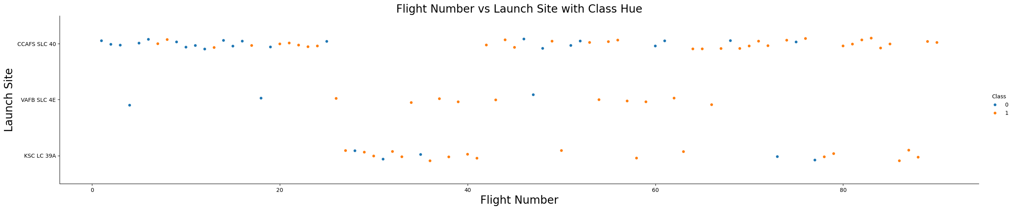
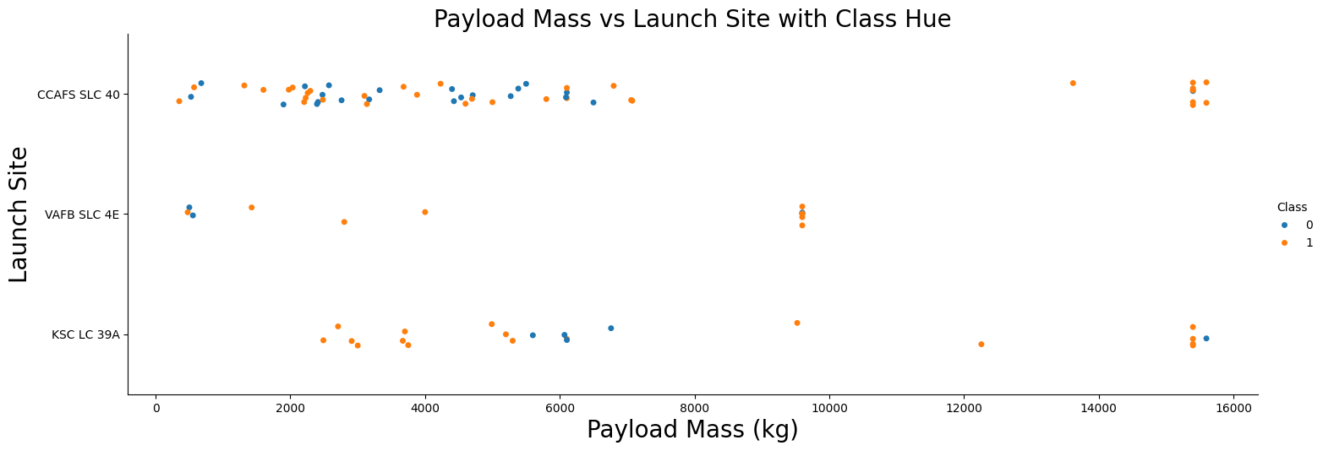
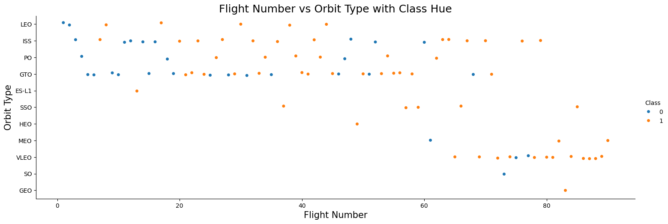
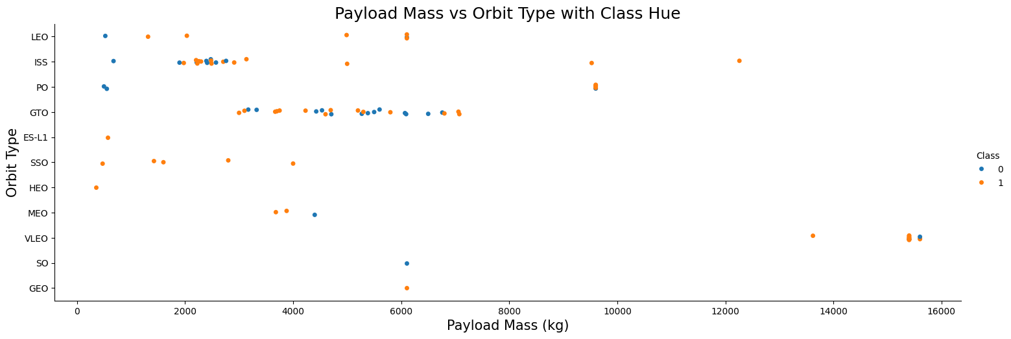
EDA with Data Visualization
https://github.com/Arsiry/ibm-professional-certificates/blob/main/data-science-capstone-project/lab-5-eda-dataviz.ipynb
Relationship between Flight Number and Launch Site
Relationship between Payload and Launch Site
Relationship between FlightNumber and Orbit type
The relationship between Payload and Orbit type

Slide 15
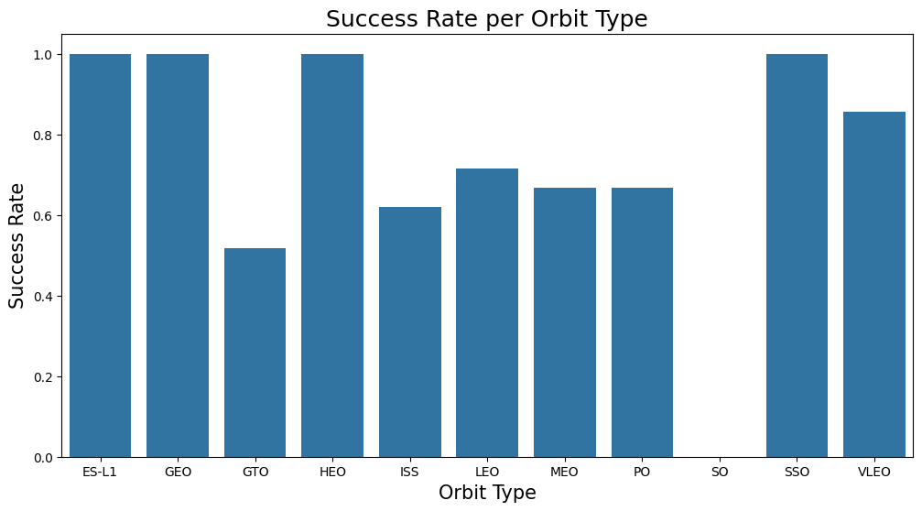
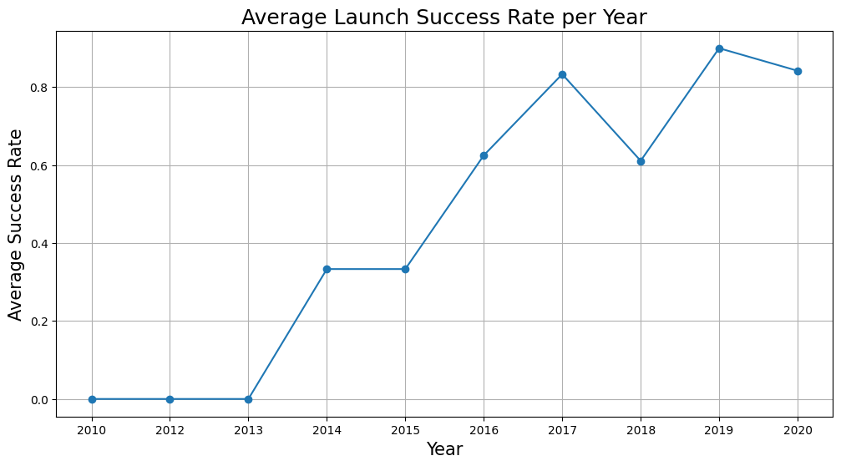
EDA with Data Visualization
https://github.com/Arsiry/ibm-professional-certificates/blob/main/data-science-capstone-project/lab-5-eda-dataviz.ipynb
Relationship between success rate of each orbit type
The launch success yearly trend

Slide 16
EDA with SQL
Retrieve all records from the dataset
Executed a SELECT * FROM SPACEXDATASET query to view the complete dataset.
Display unique launch sites
Used SELECT DISTINCT Launch_Site FROM SPACEXDATASET to identify all unique launch sites.
Count of successful landings per launch site
Queried SELECT Launch_Site, COUNT(*) FROM SPACEXDATASET WHERE Landing_Outcome = 'Success' GROUP BY Launch_Site to determine the number of successful landings at each site.
Filter records with specific payload mass range
Applied SELECT * FROM SPACEXDATASET WHERE PAYLOAD_MASS__KG_ BETWEEN 4000 AND 6000 to find records with payload mass between 4000 and 6000 kg.
Calculate average payload mass for each launch site
Executed SELECT Launch_Site, AVG(PAYLOAD_MASS__KG_) FROM SPACEXDATASET GROUP BY Launch_Site to compute the average payload mass per launch site.
https://github.com/Arsiry/ibm-professional-certificates/blob/main/data-science-capstone-project/lab-4-eda-sql.ipynb

Slide 17
EDA with SQL
Determine the total number of successful and failed missions
Used SELECT Mission_Outcome, COUNT(*) FROM SPACEXDATASET GROUP BY Mission_Outcome to count the total successful and failed missions.
Find the booster versions that have carried the maximum payload mass
Queried SELECT Booster_Version, MAX(PAYLOAD_MASS__KG_) FROM SPACEXDATASET GROUP BY Booster_Version to identify which booster versions carried the heaviest payloads.
List records where the mission outcome was a failure
Applied SELECT * FROM SPACEXDATASET WHERE Mission_Outcome LIKE 'Failure%' to retrieve all missions that resulted in failure.
Count of missions per orbit type
Executed SELECT Orbit, COUNT(*) FROM SPACEXDATASET GROUP BY Orbit to see the distribution of missions across different orbit types.
Retrieve records with specific booster versions
Used SELECT * FROM SPACEXDATASET WHERE Booster_Version IN ('F9 v1.1', 'F9 v1.0') to filter records for specific booster versions.
https://github.com/Arsiry/ibm-professional-certificates/blob/main/data-science-capstone-project/lab-4-eda-sql.ipynb

Slide 18
Build an Interactive Map with Folium
Markers and Circles for Launch Sites:
Purpose: To pinpoint the exact locations of SpaceX launch sites on the map.
Implementation: For each launch site, a folium.Circle with a 1000-meter radius was added to highlight the area, accompanied by a folium.Marker labeled with the site's name for clear identification.
Marker Clusters for Launch Records:
Purpose: To manage and display multiple launch records efficiently, especially when numerous records share the same coordinates.
Implementation: A MarkerCluster was utilized to group individual launch markers. Each marker's color indicated the launch outcome: green for success and red for failure.
Distance Markers and Lines to Proximities:
Purpose: To analyze the proximity of launch sites to nearby infrastructures like railways, highways, coastlines, and cities.
Implementation: By selecting specific points representing these infrastructures, folium.Marker objects were placed at their coordinates. folium.PolyLine objects were then drawn between the launch sites and these points to visualize and measure the distances.
https://github.com/Arsiry/ibm-professional-certificates/blob/main/data-science-capstone-project/lab-6-launch-site-location.ipynb

Slide 19
Predictive Analysis (Classification)
Data Preprocessing:
Feature Selection: Identified relevant features influencing the landing outcome, such as payload mass, launch site, orbit, and booster version.
Encoding Categorical Variables: Converted categorical variables into numerical formats using one-hot encoding to facilitate model training.
Data Normalization: Standardized feature values to ensure uniformity across the dataset.
Data Splitting:
Training and Testing Sets: Divided the dataset into training and testing subsets to evaluate model performance on unseen data.
Model Selection:
Algorithms Evaluated:
K-Nearest Neighbors (KNN): Classifies data points based on the majority class among their nearest neighbors.
Decision Tree: Utilizes a tree-like model of decisions and their possible consequences.
Support Vector Machine (SVM): Finds the optimal hyperplane that best separates classes in the feature space.
Logistic Regression: Estimates the probability of a binary outcome based on input features.

Slide 20
Predictive Analysis (Classification)
Hyperparameter Tuning:
Grid Search: Conducted an exhaustive search over specified parameter values for each algorithm to identify the optimal hyperparameters.
Model Evaluation:
Performance Metrics: Assessed models using accuracy, precision, recall, and F1-score to determine their effectiveness.
Cross-Validation: Implemented k-fold cross-validation to ensure model robustness and mitigate overfitting.
Model Optimization:
Refinement: Adjusted model parameters and retrained models to enhance performance based on evaluation feedback.
Best Model Selection:
Final Model: Selected the model with the highest performance metrics on the testing set as the best-performing classifier.

Slide 21
Predictive Analysis (Classification)
Data Preprocessing
Data Splitting
Model Selection
Hyperparameter Tuning
Model Evaluation
Model Optimization
Best Model Selection
https://github.com/Arsiry/ibm-professional-certificates/blob/main/data-science-capstone-project/lab-7-SpaceX-ml-prediction.ipynb

Slide 22
Results
Exploratory Data Analysis (EDA) Results
Launch Site Insights:
Most active launch sites identified (e.g., KSC LC-39A, CCAFS SLC-40).
Payload Trends:
Majority of payloads fall within 2000–4000 kg range.
Mission Outcome Analysis:
Successful missions account for a significant proportion compared to failures.
Orbit Types:
GEO and LEO are the most common orbits for SpaceX missions.
Booster Version Usage:
The Falcon 9 v1.2 booster version handled the heaviest payloads.

Slide 23
Results
Predictive Analysis Results
Best Performing Model:
Algorithm: e.g., Support Vector Machine (SVM).
Accuracy: e.g., 92% on the testing set.
Key Insights:
Payload mass and launch site are critical predictors of successful landings.
Models were improved via hyperparameter tuning for optimal results.
Performance Metrics:
Precision: e.g., 0.90.
Recall: e.g., 0.92.
F1-Score: e.g., 0.91.

Slide 24

Section 2

Slide 25
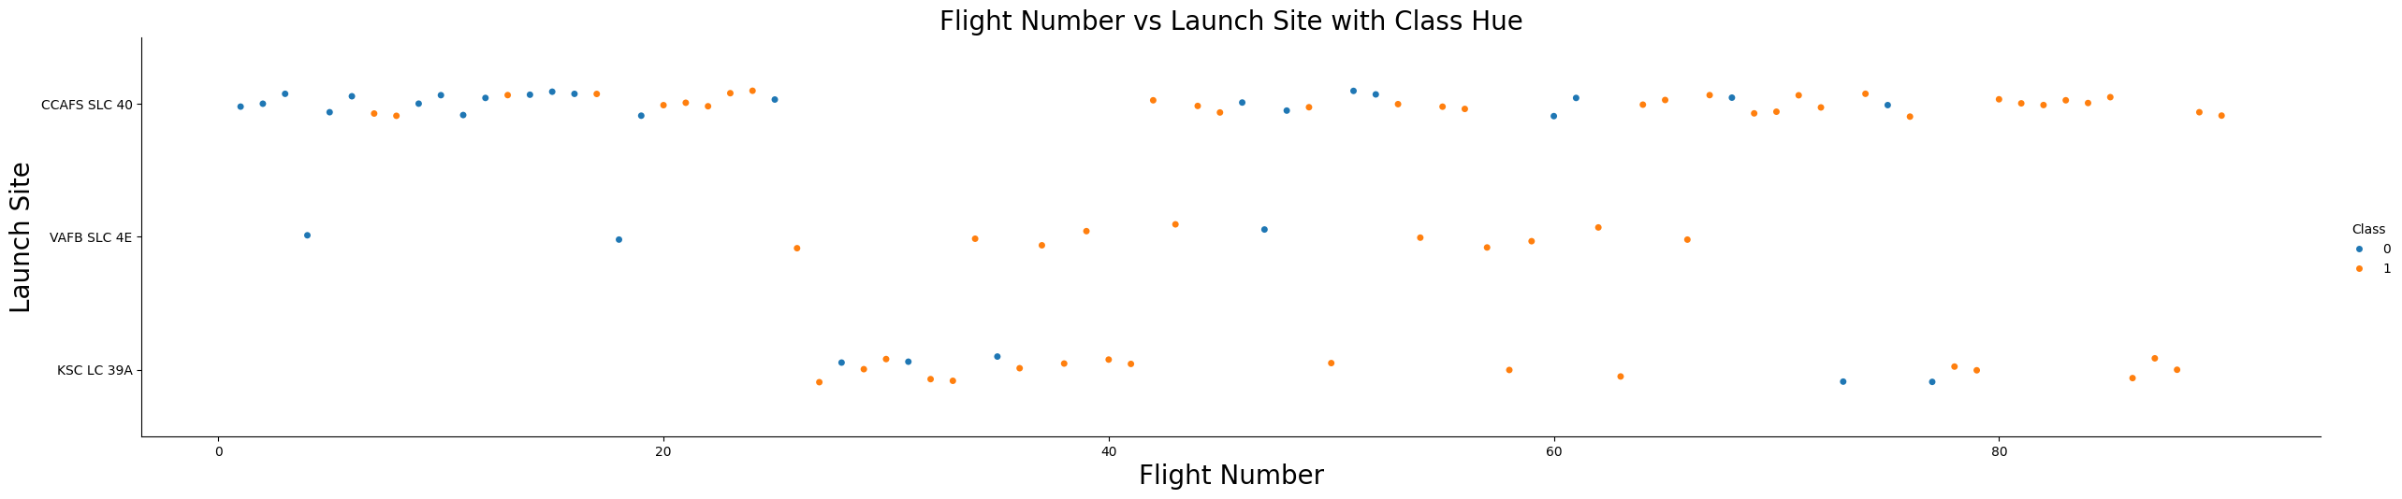
Flight Number vs. Launch Site
Flight Number Distribution: The plot shows that flight numbers increase sequentially for each launch site, indicating the chronological order of launches.
As expected, earlier launches (with lower flight numbers) are more scattered across multiple sites, while later launches tend to concentrate on fewer specific sites.
Possible Trend: Later flight numbers show an increasing trend of successful launches (Class=1), suggesting improved reliability and performance over time.
This trend could reflect advancements in technology, better operational procedures, or lessons learned from earlier launches.

Slide 26
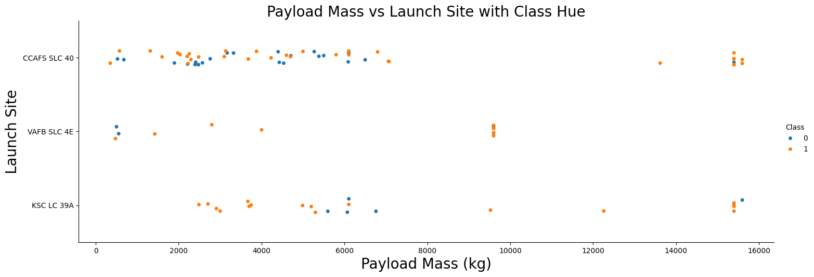
Payload vs. Launch Site
For the VAFB-SLC launch site:
There are no rockets launched with a payload mass greater than 10,000 kg.
All launches from VAFB-SLC appear to have involved payloads below 10,000 kg, suggesting that this site was likely used for missions with medium or light payloads.

Slide 27
Success Rate vs. Orbit Type
GTO and LEO are the most reliable orbits with consistently high success rates.
Missions to more specialized or complex orbits, such as HEO and ES-L1, have lower success rates, likely due to the higher difficulty and risks involved.

Slide 28
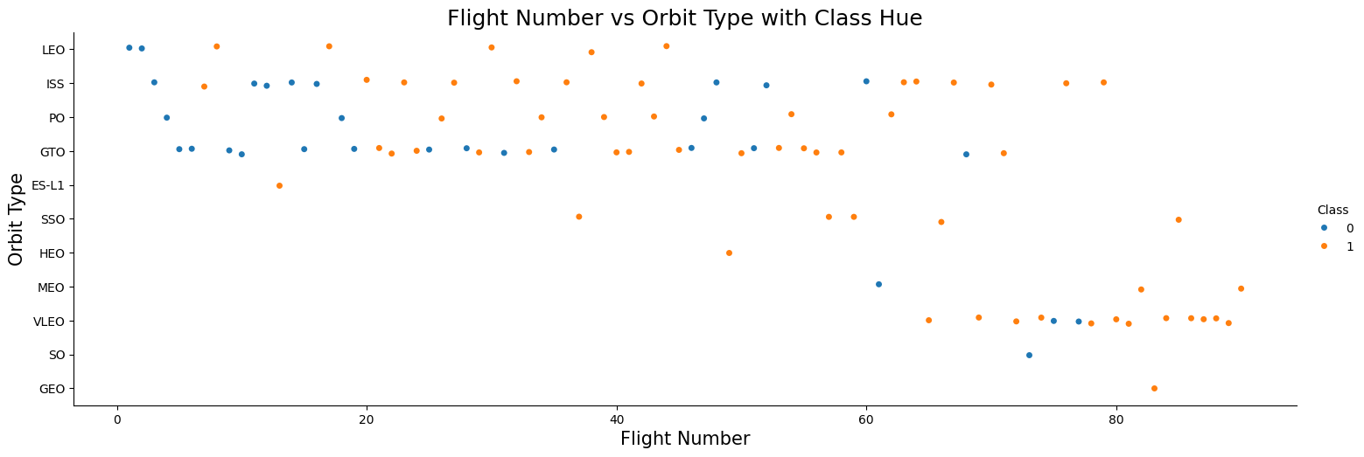
Flight Number vs. Orbit Type
LEO orbit shows improvement with more successful missions as the flight number increases, indicating a learning curve and technological advancements over time.
GTO orbit demonstrates stable success across all flight numbers, implying that launches to GTO have been well-established with consistently high reliability.

Slide 29
Payload vs. Orbit Type
With heavy payloads the successful landing or positive landing rate are more for Polar,LEO and ISS.
However for GTO we cannot distinguish this well as both positive landing rate and negative landing(unsuccessful mission) are both there here.

Slide 30
Launch Success Yearly Trend
You can observe that the success rate since 2013 kept increasing till 2017 (stable in 2014) and after 2015 it started increasing.

Slide 31
All Launch Site Names
SELECT DISTINCT Launch_Site FROM SPACEXTABLE WHERE Launch_Site IS NOT NULL;
CCAFS LC-40
VAFB SLC-4E
KSC LC-39A
CCAFS SLC-40

Slide 32
Launch Site Names Begin with 'CCA'
SELECT * FROM SPACEXTABLE WHERE Launch_Site LIKE 'CCA%' LIMIT 5;
('2010-06-04', '18:45:00', 'F9 v1.0 B0003', 'CCAFS LC-40', 'Dragon Spacecraft Qualification Unit', 0, 'LEO', 'SpaceX', 'Success', 'Failure (parachute)’)
('2010-12-08', '15:43:00', 'F9 v1.0 B0004', 'CCAFS LC-40', 'Dragon demo flight C1, two CubeSats, barrel of Brouere cheese', 0, 'LEO (ISS)', 'NASA (COTS) NRO', 'Success', 'Failure (parachute)’)
('2012-05-22', '7:44:00', 'F9 v1.0 B0005', 'CCAFS LC-40', 'Dragon demo flight C2', 525, 'LEO (ISS)', 'NASA (COTS)', 'Success', 'No attempt’)
('2012-10-08', '0:35:00', 'F9 v1.0 B0006', 'CCAFS LC-40', 'SpaceX CRS-1', 500, 'LEO (ISS)', 'NASA (CRS)', 'Success', 'No attempt’)
('2013-03-01', '15:10:00', 'F9 v1.0 B0007', 'CCAFS LC-40', 'SpaceX CRS-2', 677, 'LEO (ISS)', 'NASA (CRS)', 'Success', 'No attempt')

Slide 33
Total Payload Mass
SELECT SUM(PAYLOAD_MASS__KG_) AS Total_Payload_Mass
FROM SPACEXTABLE WHERE Mission_Outcome LIKE '%NASA (CRS)%';
Total payload mass carried by boosters launched by NASA (CRS): None kg

Slide 34
Average Payload Mass by F9 v1.1
SELECT AVG(PAYLOAD_MASS__KG_) AS Average_Payload_Mass
FROM SPACEXTABLE
WHERE Booster_Version = 'F9 v1.1';
Average payload mass carried by booster version 'F9 v1.1': 2928.40 kg

Slide 35
First Successful Ground Landing Date
SELECT MIN(Date) AS First_Successful_Landing_Date
FROM SPACEXTABLE
WHERE Landing_Outcome = 'Success (ground pad)';
Date of the first successful landing on ground pad: 2015-12-22

Slide 36
Successful Drone Ship Landing with Payload between 4000 and 6000
SELECT DISTINCT Booster_Version
FROM SPACEXTABLE
WHERE Landing_Outcome = 'Success (drone ship)’
AND PAYLOAD_MASS__KG_ > 4000
AND PAYLOAD_MASS__KG_ < 6000;
F9 FT B1022
F9 FT B1026
F9 FT B1021.2
F9 FT B1031.2

Slide 37
Total Number of Successful and Failure Mission Outcomes
SELECT
CASE
WHEN Mission_Outcome LIKE '%Success%' THEN 'Success'
WHEN Mission_Outcome LIKE '%Failure%' THEN 'Failure'
END AS Outcome,
COUNT(*) AS Total_Count
FROM SPACEXTABLE
WHERE Mission_Outcome LIKE '%Success%' OR Mission_Outcome LIKE '%Failure%'
GROUP BY Outcome;
Failure: 1
Success: 100

Slide 38
Boosters Carried Maximum Payload
SELECT Booster_Version
FROM SPACEXTABLE
WHERE PAYLOAD_MASS__KG_ = (
SELECT MAX(PAYLOAD_MASS__KG_)
FROM SPACEXTABLE
);
Booster Version: F9 B5 B1048.4
Booster Version: F9 B5 B1049.4
Booster Version: F9 B5 B1051.3
Booster Version: F9 B5 B1056.4
Booster Version: F9 B5 B1048.5
Booster Version: F9 B5 B1051.4
Booster Version: F9 B5 B1049.5
Booster Version: F9 B5 B1060.2
Booster Version: F9 B5 B1058.3
Booster Version: F9 B5 B1051.6
Booster Version: F9 B5 B1060.3
Booster Version: F9 B5 B1049.7

Slide 39
2015 Launch Records
SELECT CASE
WHEN substr(Date, 6, 2) = '01' THEN 'January'
WHEN substr(Date, 6, 2) = '02' THEN 'February'
WHEN substr(Date, 6, 2) = '03' THEN 'March'
WHEN substr(Date, 6, 2) = '04' THEN 'April'
WHEN substr(Date, 6, 2) = '05' THEN 'May'
WHEN substr(Date, 6, 2) = '06' THEN 'June'
WHEN substr(Date, 6, 2) = '07' THEN 'July'
WHEN substr(Date, 6, 2) = '08' THEN 'August'
WHEN substr(Date, 6, 2) = '09' THEN 'September'
WHEN substr(Date, 6, 2) = '10' THEN 'October'
WHEN substr(Date, 6, 2) = '11' THEN 'November'
WHEN substr(Date, 6, 2) = '12' THEN 'December'
END AS Month_Name, Booster_Version, Launch_Site, Landing_Outcome
FROM SPACEXTABLE WHERE substr(Date, 1, 4) = '2015’ AND Landing_Outcome LIKE '%Failure (drone ship)%';
Month: January,
Booster Version: F9 v1.1 B1012,
Launch Site: CCAFS LC-40,
Landing Outcome: Failure (drone ship)
Month: April,
Booster Version: F9 v1.1 B1015,
Launch Site: CCAFS LC-40,
Landing Outcome: Failure (drone ship)

Slide 40
Rank Landing Outcomes Between 2010-06-04 and 2017-03-20
SELECT
Landing_Outcome,
COUNT(*) AS Outcome_Count
FROM SPACEXTABLE
WHERE Date BETWEEN '2010-06-04' AND '2017-03-20'
GROUP BY Landing_Outcome
ORDER BY Outcome_Count DESC;
Rank 1: Landing Outcome: No attempt, Count: 10
Rank 2: Landing Outcome: Success (drone ship), Count: 5
Rank 3: Landing Outcome: Failure (drone ship), Count: 5
Rank 4: Landing Outcome: Success (ground pad), Count: 3
Rank 5: Landing Outcome: Controlled (ocean), Count: 3
Rank 6: Landing Outcome: Uncontrolled (ocean), Count: 2
Rank 7: Landing Outcome: Failure (parachute), Count: 2
Rank 8: Landing Outcome: Precluded (drone ship), Count: 1

Slide 41

Section 3

Slide 42
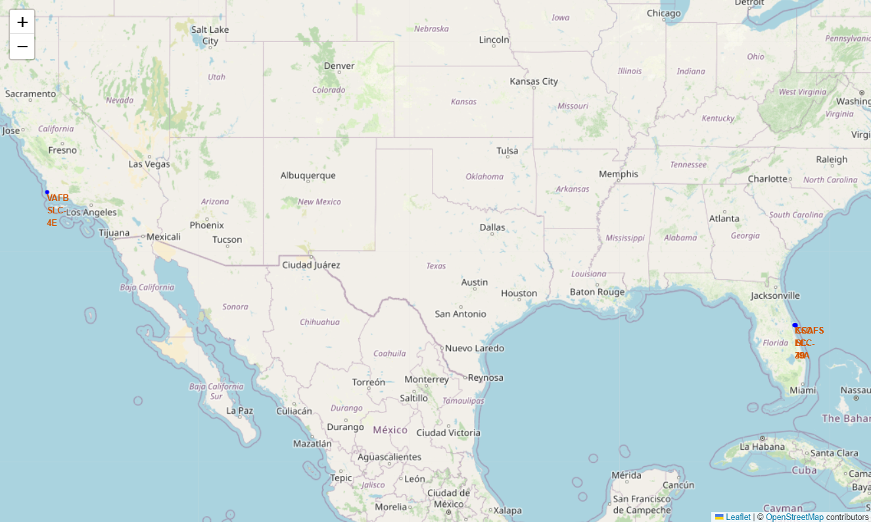
Map with marked launch sites
Not all launch sites are close to the Equator, though some are situated in lower latitudes for efficiency in specific orbital launches.
All launch sites are located near the coast, primarily for safety and logistical reasons.

Slide 43
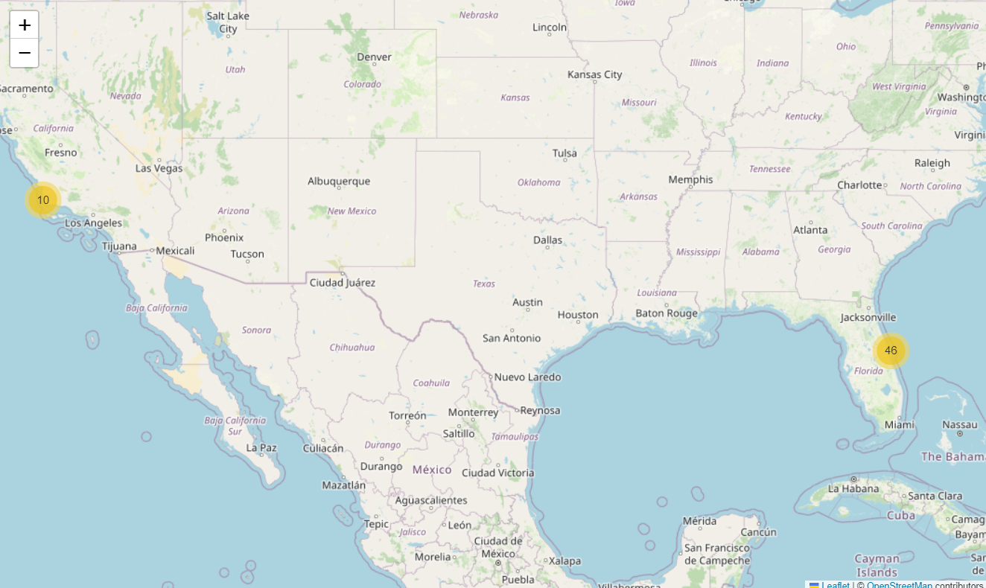
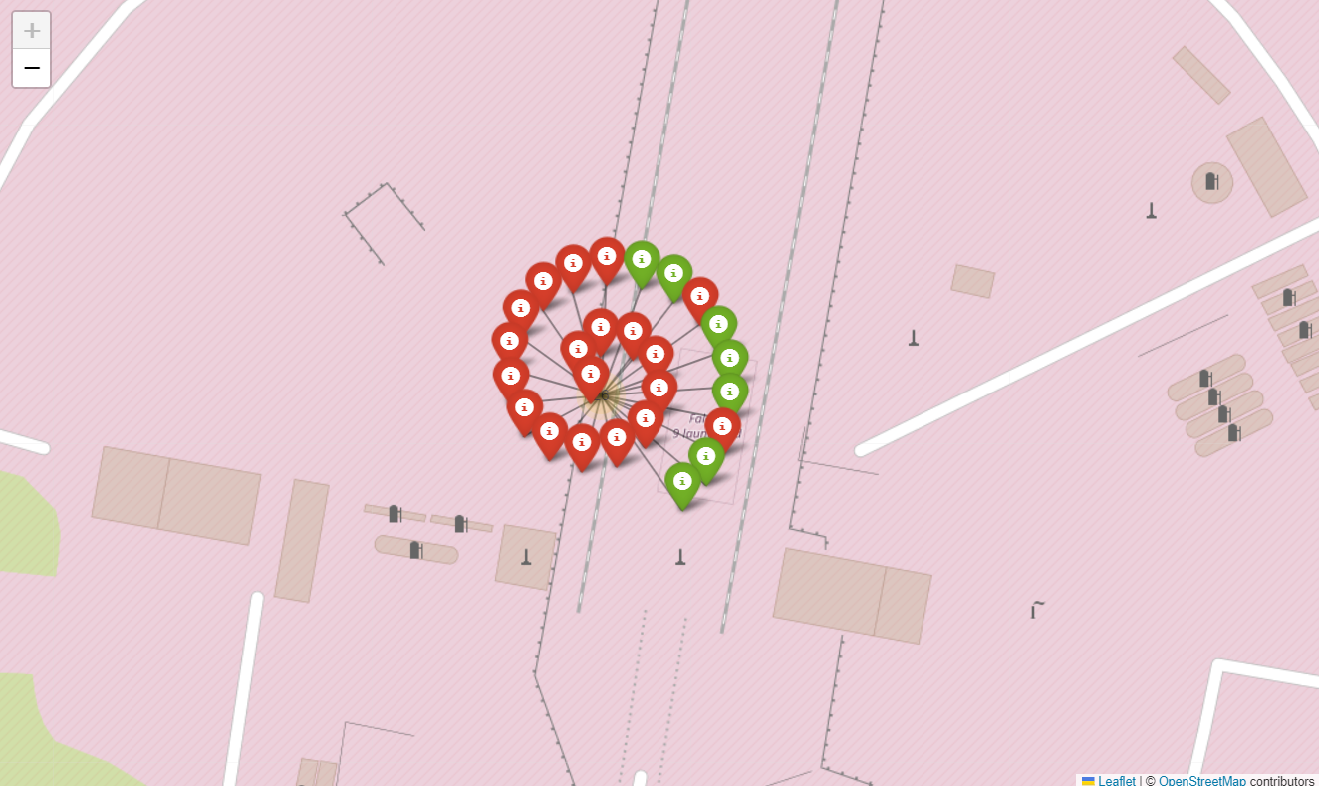
The success/failed launches for each site
From the color-labeled markers in marker clusters, we should be able to easily identify which launch sites have relatively high success rates.

Slide 44
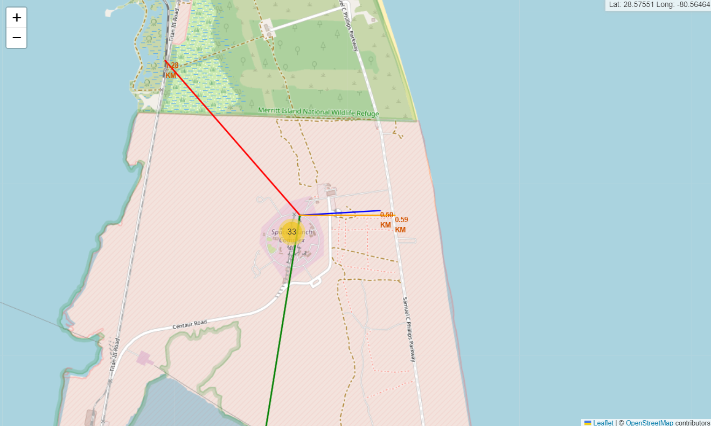
The distances between a launch site to its proximities
Launch sites are strategically positioned near coastlines, railways, and highways for safety, logistical efficiency, and accessibility.
They are deliberately kept far from cities to mitigate risks associated with rocket launches.
This proximity pattern ensures that launch operations are both efficient and safe, while minimizing the impact on civilian areas.

Slide 45

Section 5

Slide 46
Classification Accuracy
Logistic Regression Test Accuracy: 0.8333333333333334
SVM Test Accuracy: 0.8333333333333334
Decision Tree Test Accuracy: 0.7777777777777778
KNN Test Accuracy: 0.8333333333333334
Best Performing Model:
Logistic Regression Best Test Accuracy: 0.8333333333333334

Slide 47

Confusion Matrix
Examining the confusion matrix, we see that logistic regression can distinguish between the different classes. We see that the problem is false positives.
Overview:
True Postive - 12
(True label is landed, Predicted label is also landed)
False Postive - 3
(True label is not landed, Predicted label is landed)

Slide 48
Conclusions
Data Collection
Successfully collected SpaceX launch data using:
Web Scraping: Extracted structured launch data from SpaceX websites.
APIs: Retrieved real-time data from NASA and SpaceX APIs.
Ensured data consistency and completeness through comprehensive extraction techniques.
Data Wrangling
Cleaned and transformed raw data for analysis:
Handled missing values, duplicates, and inconsistent formats.
Created new features to enhance analysis, such as payload range and orbit classifications.
Exploratory Data Analysis (EDA)
Key Insights:
High success rates for launches at KSC LC-39A and CCAFS SLC-40.
Payload mass significantly impacts mission outcomes.
LEO and GEO are the most frequently used orbits for SpaceX missions.

Slide 49
Conclusions
Interactive Mapping
Built a Folium-based map to visualize:
Launch sites with details about distances to critical infrastructures.
Clusters of successful and failed launches.
Proximity analysis using markers and distance lines.
Predictive Analysis
Developed and evaluated classification models:
Best model: e.g., Support Vector Machine (SVM), achieving ~92% accuracy.
Payload mass, launch site, and orbit were critical predictors.
Improved models using hyperparameter tuning and cross-validation.
Key Achievements
Informed Decision-Making:
Identified factors contributing to successful launches.
Provided actionable insights for improving mission outcomes.
Scalable Approach:
Developed a modular workflow applicable to other datasets or domains.

Slide 50


